Slide 1

Emerging & Persistent Contaminants
In Upper Ping River Catchment, Thailand
Lien Foundation & NTU, Singapore
Mae Jo University, Thailand

Slide 2
Hypotheses | Research Questions
Unique signals for different land covers (urban <> rural/agriculture)
Temporal variation of “some” contaminants (seasonality)
Some contaminants will be persistent (human secreted; point sources)
Ground water and surface water signatures are often disconnected
Mae Kha Canal (Chiang Mai city) suffers extreme pollution (loads the Ping)

Slide 3

METHODS
TYPE OF CONTAMINANTS
Industrial Chemicals
Personal Care Products
Medical Chemicals
Pesticides
Natural Signals
LAND-USES CONSIDERED
Urban (domestic, industry, commercial, manufacturing)
Peri-urban (domestic, commercial, agriculture)
Rural (agriculture, livestock, domestic, etc)
Remote (forest, farm signal)
Analyses include the following:
[1] Non-targeted analysis (Realm of “all” compounds present)
[2] Target Analysis (Track selected indictor compounds)
[3] Dissolved organic carbon (DOC)
[4] EEM (Characterize DOC; alternation of natural signal)
[5] ICP-MS (Potentially toxic elements)
[6] Bioassay (Health risk of compounds in water)
[7] Major ions (Nitrate, Sulfate, Ca, Mg)
[8] Basic: pH, Conductivity, Salinity (Acid rain or mine drainage)
SCALE
Temporal trends
Spatial variation

Slide 4
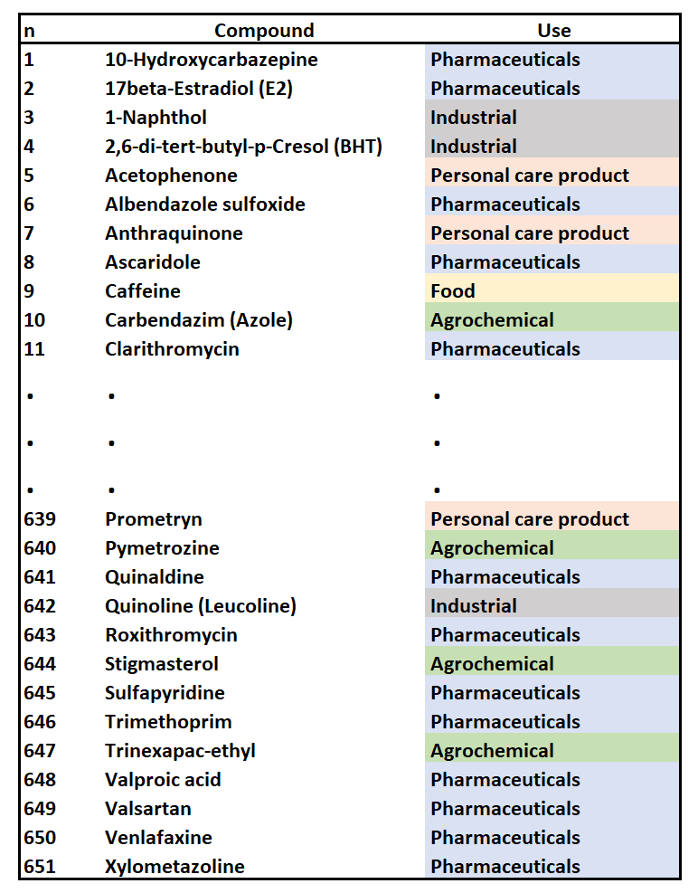
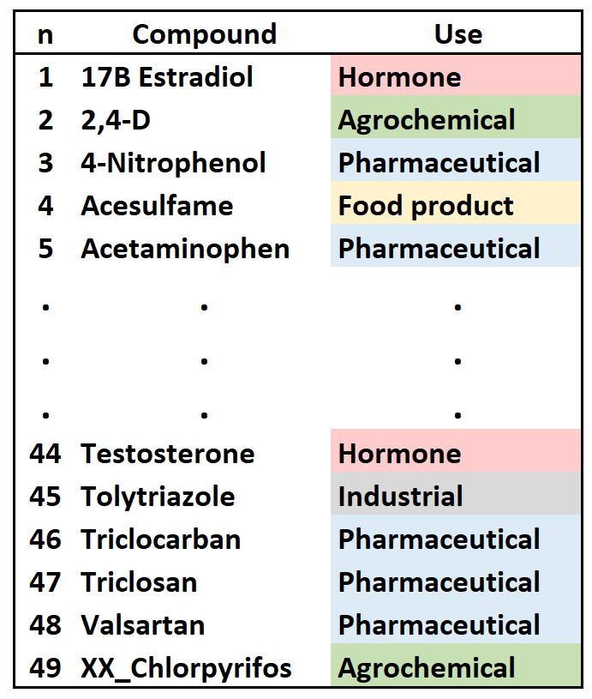
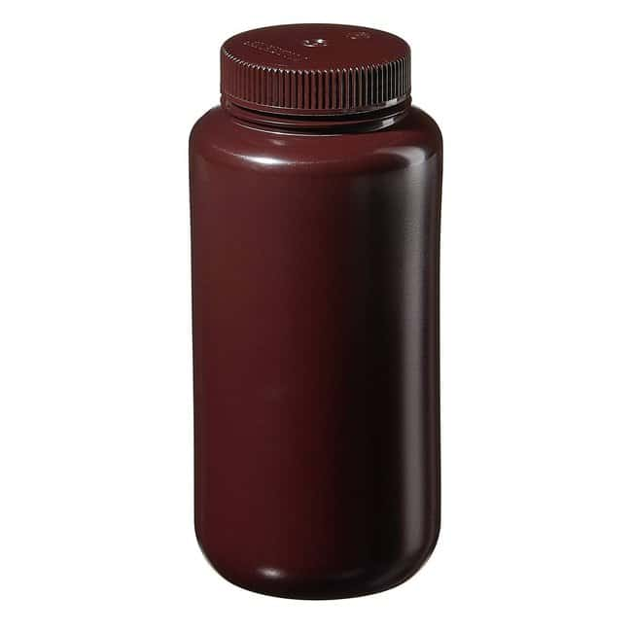
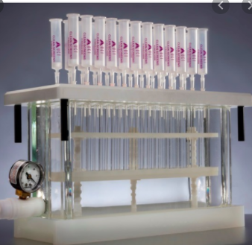
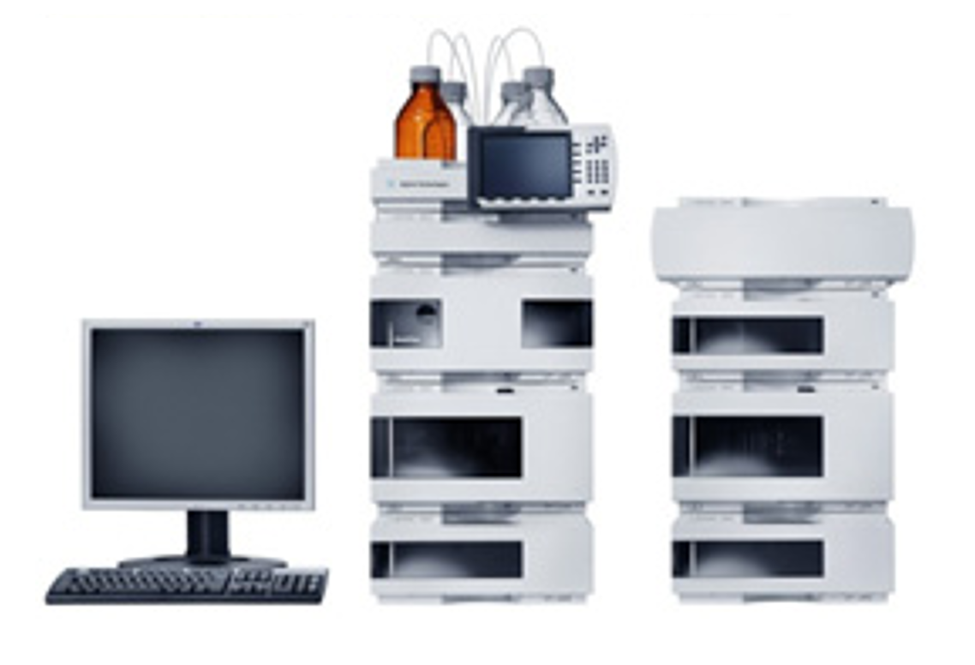
Non-targeted Analysis
651 compounds
Several Land uses
Variety of compounds
Non-targeted Analysis
49 compounds
3 Land uses
5 “types” of compounds
Methods
1000-mL samples
SPE followed by LC/MS
Reduce to
a subset of
indicator
compounds
Solid Phase Extraction (SPE)
Notable missing compounds: Glyphosate & Paraquat
Popular Herbicides used ubiquitously in Thailand
Liquid Chromatography/ Mass Spec

Slide 5
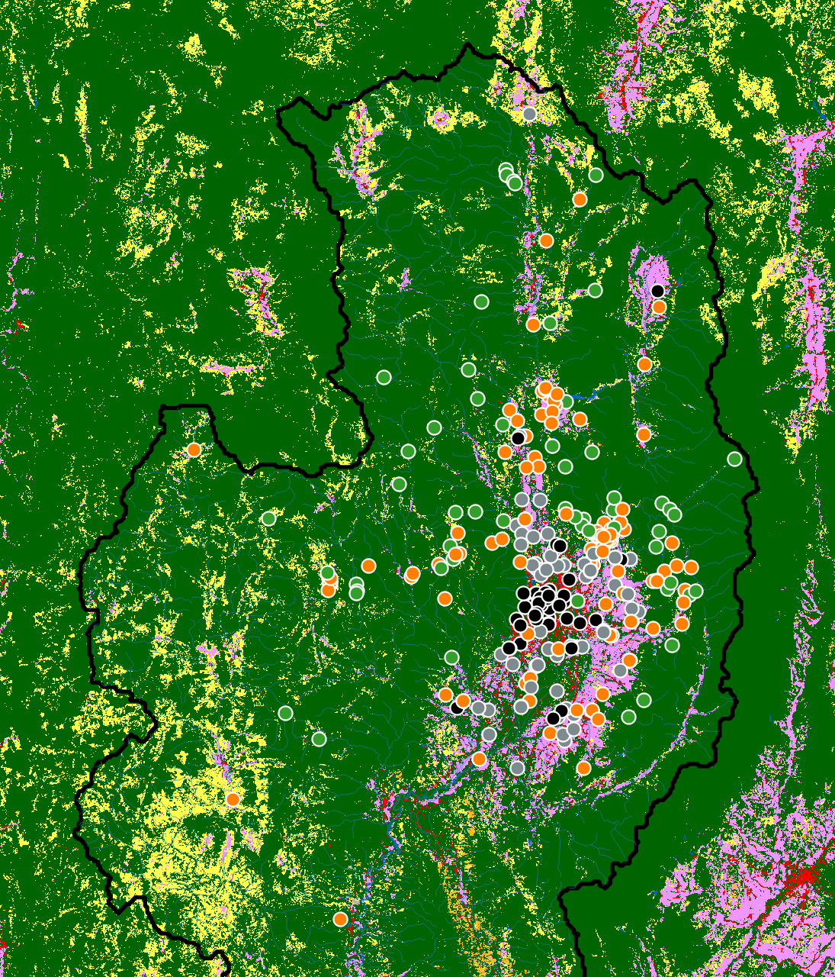
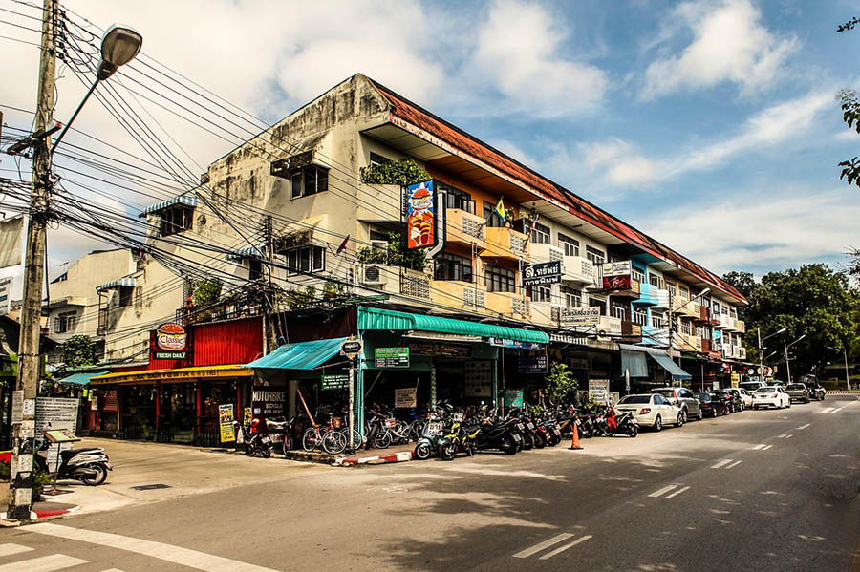
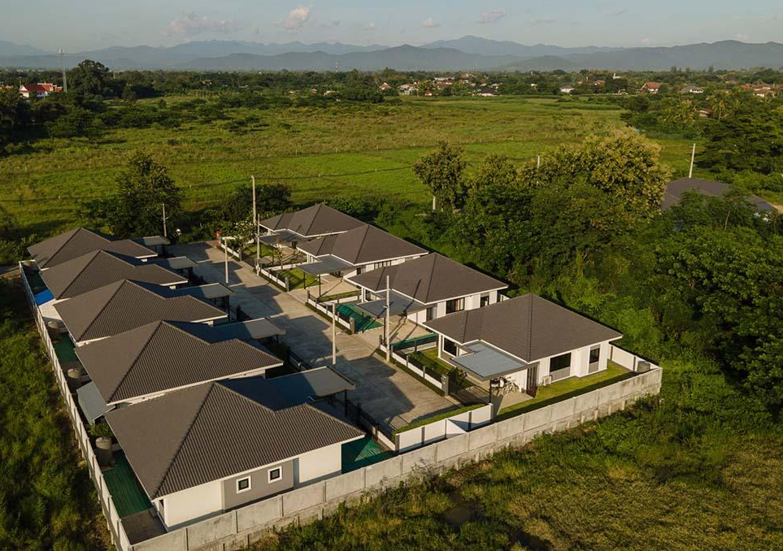
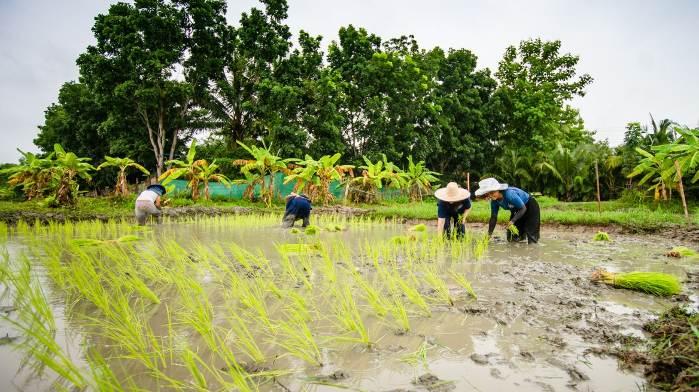
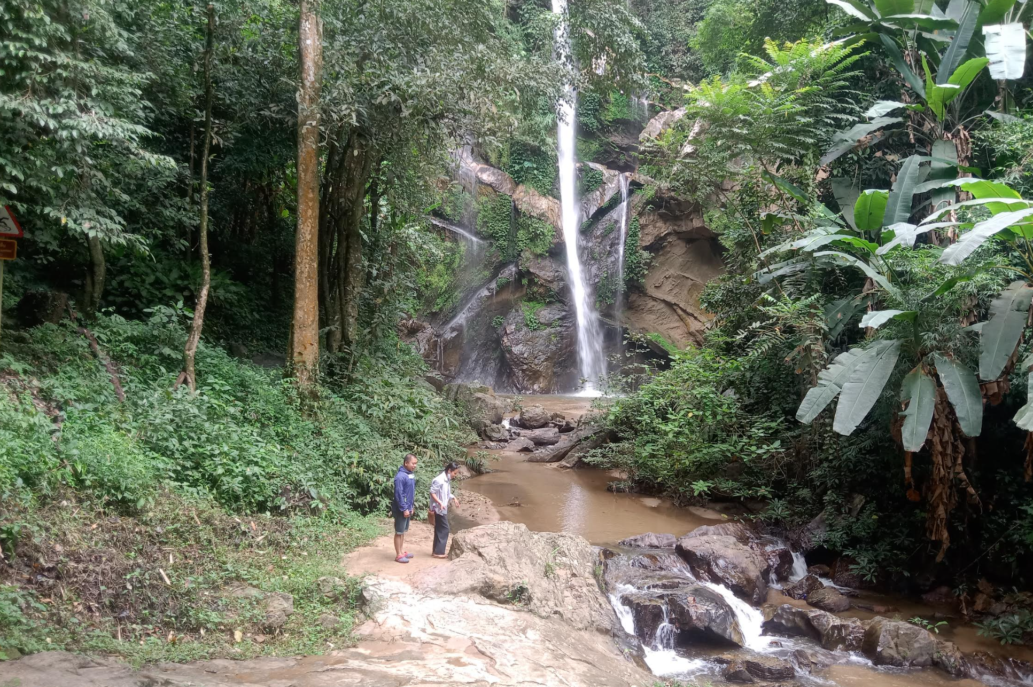
Remote
Rural
Peri-urban
Urban
FOREST
SAMPLING
Remote Rural Peri-urban Urban
UPLAND
AGRICULTURE
WET RICE

Slide 6
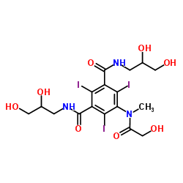
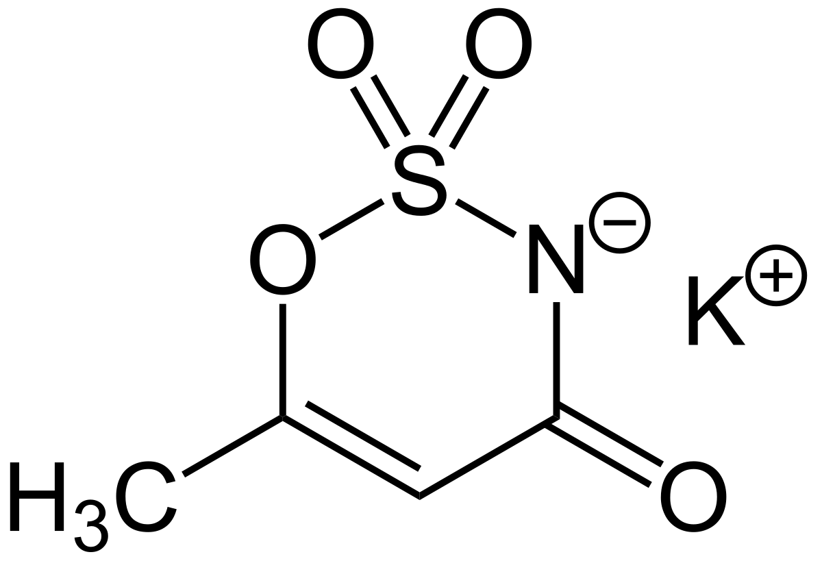
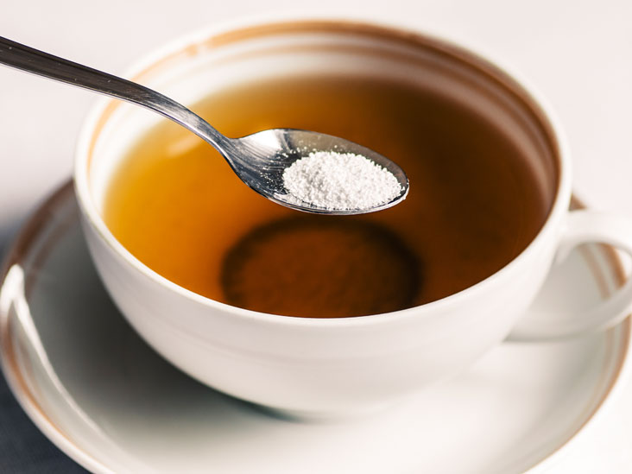
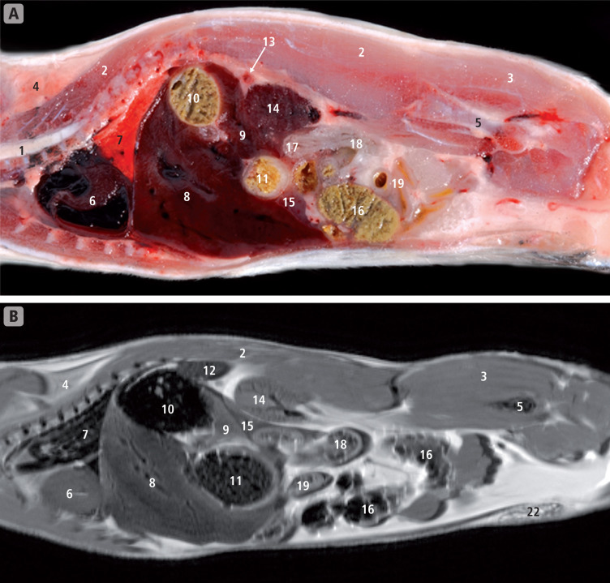
ACESULFAME
Two Examples
IOMEPROL
X-RAY contrasting agent
Excreted from the body as
a waste product
Artificial Sweetener
Indicator of sources & and
water treatment efficiency

Slide 7
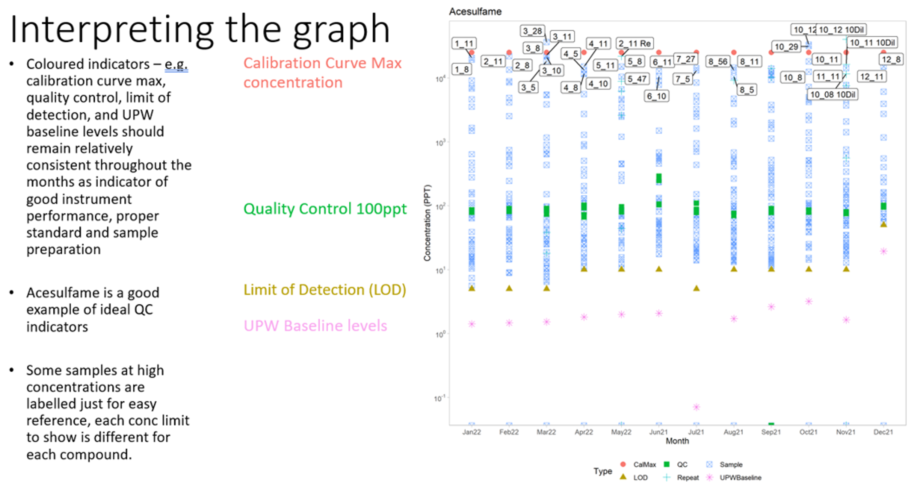
EXAMPLE: ACESULFAME
Site 11 (Mae Kha Canal): PERSISTENT
←-------- Range of values ------→
Change over time ---------------------------→

Slide 8
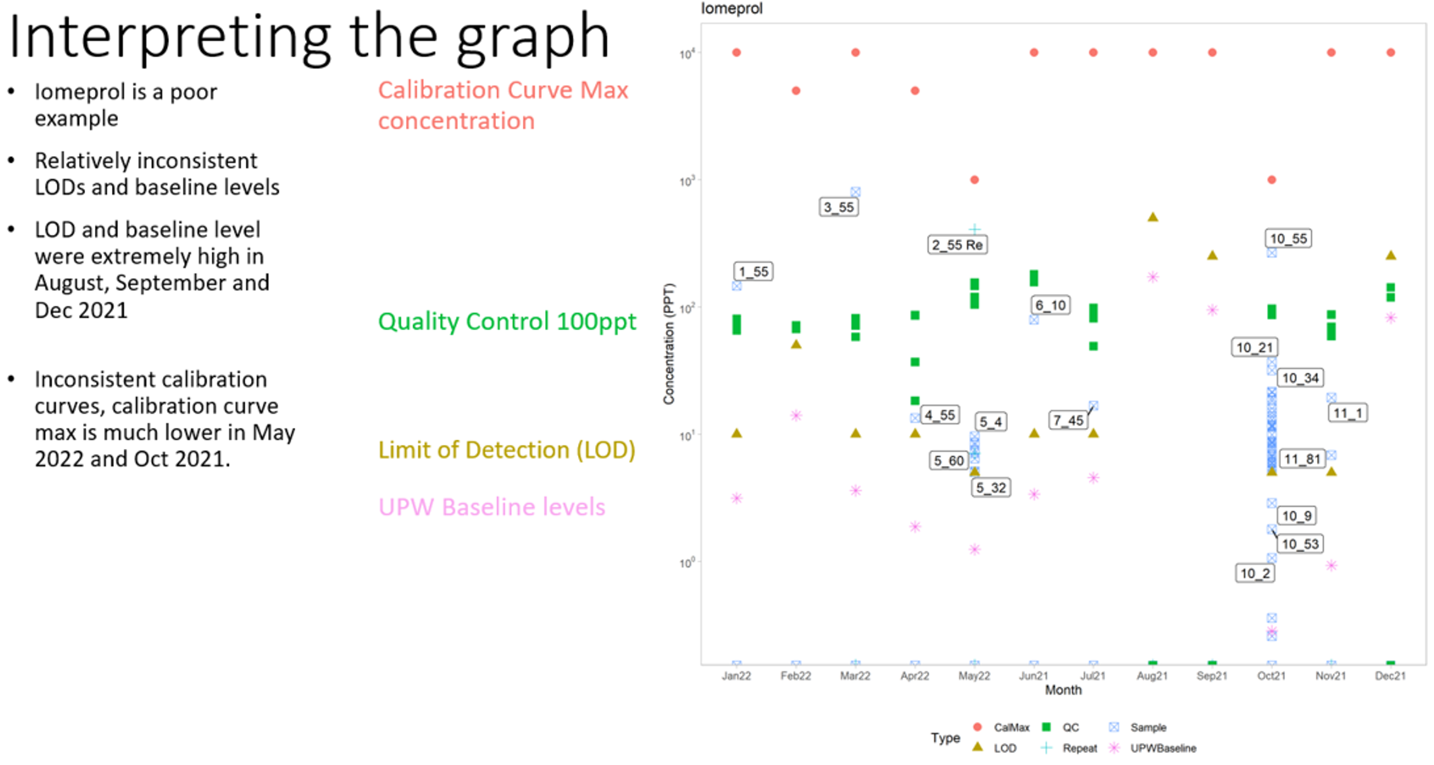
EXAMPLE: IOMEPROL
Drainage from Hospitals (reliable)
This compound is detected inconsistently; therefore
Additional work is needed on QA/QC

Slide 9
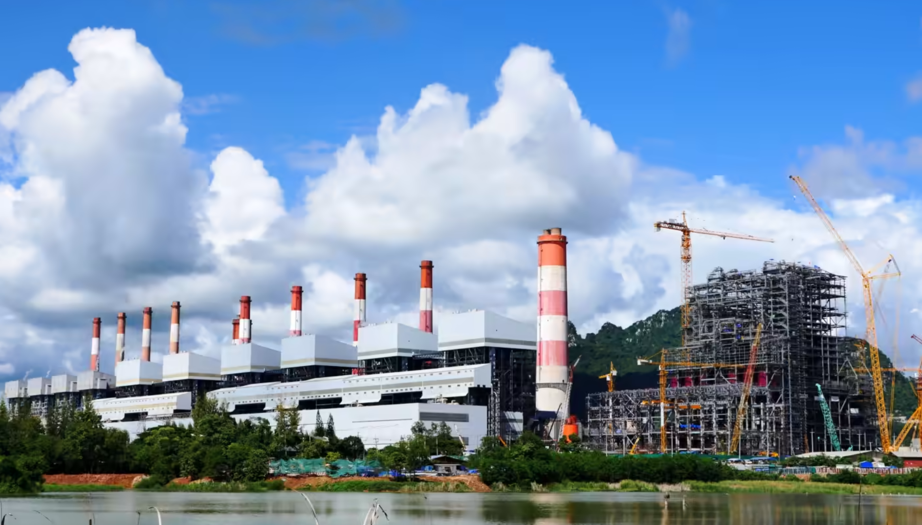
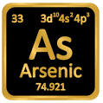
Mae Moh Power Plant
Deep wells bring Arsenic to surface
Drains into river system
Sulphate loading

Slide 10
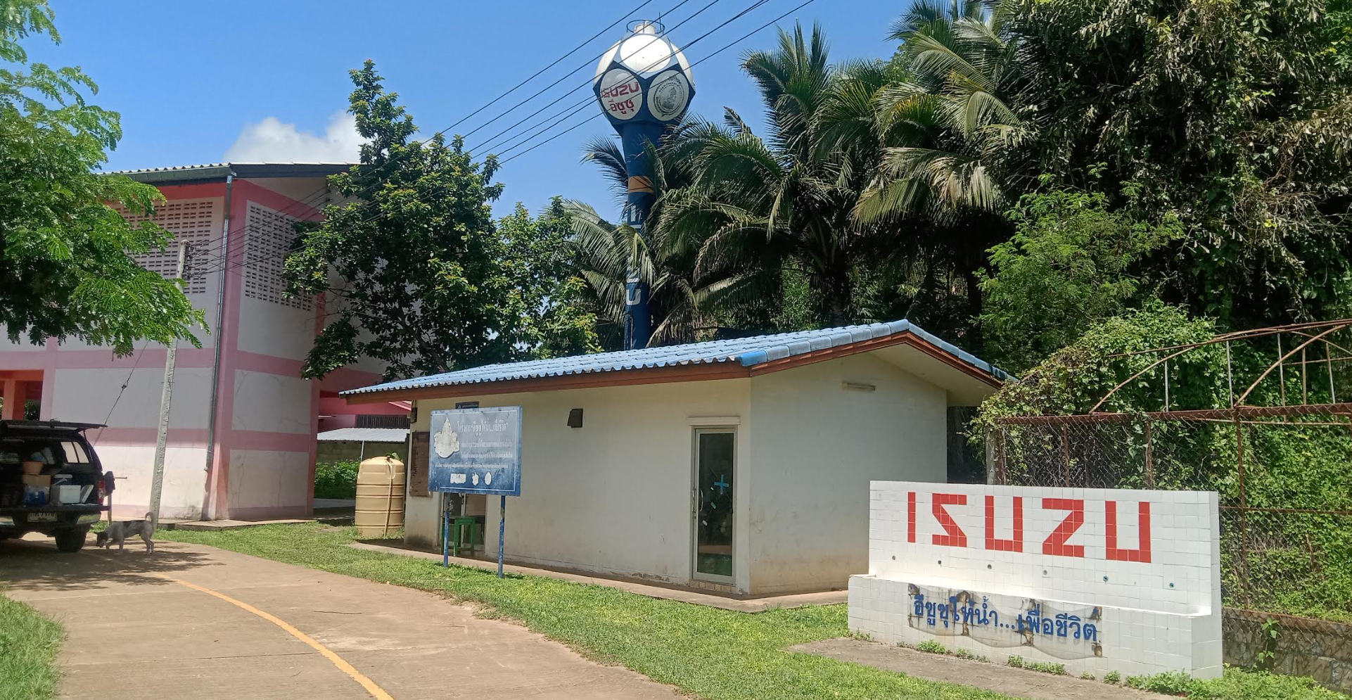
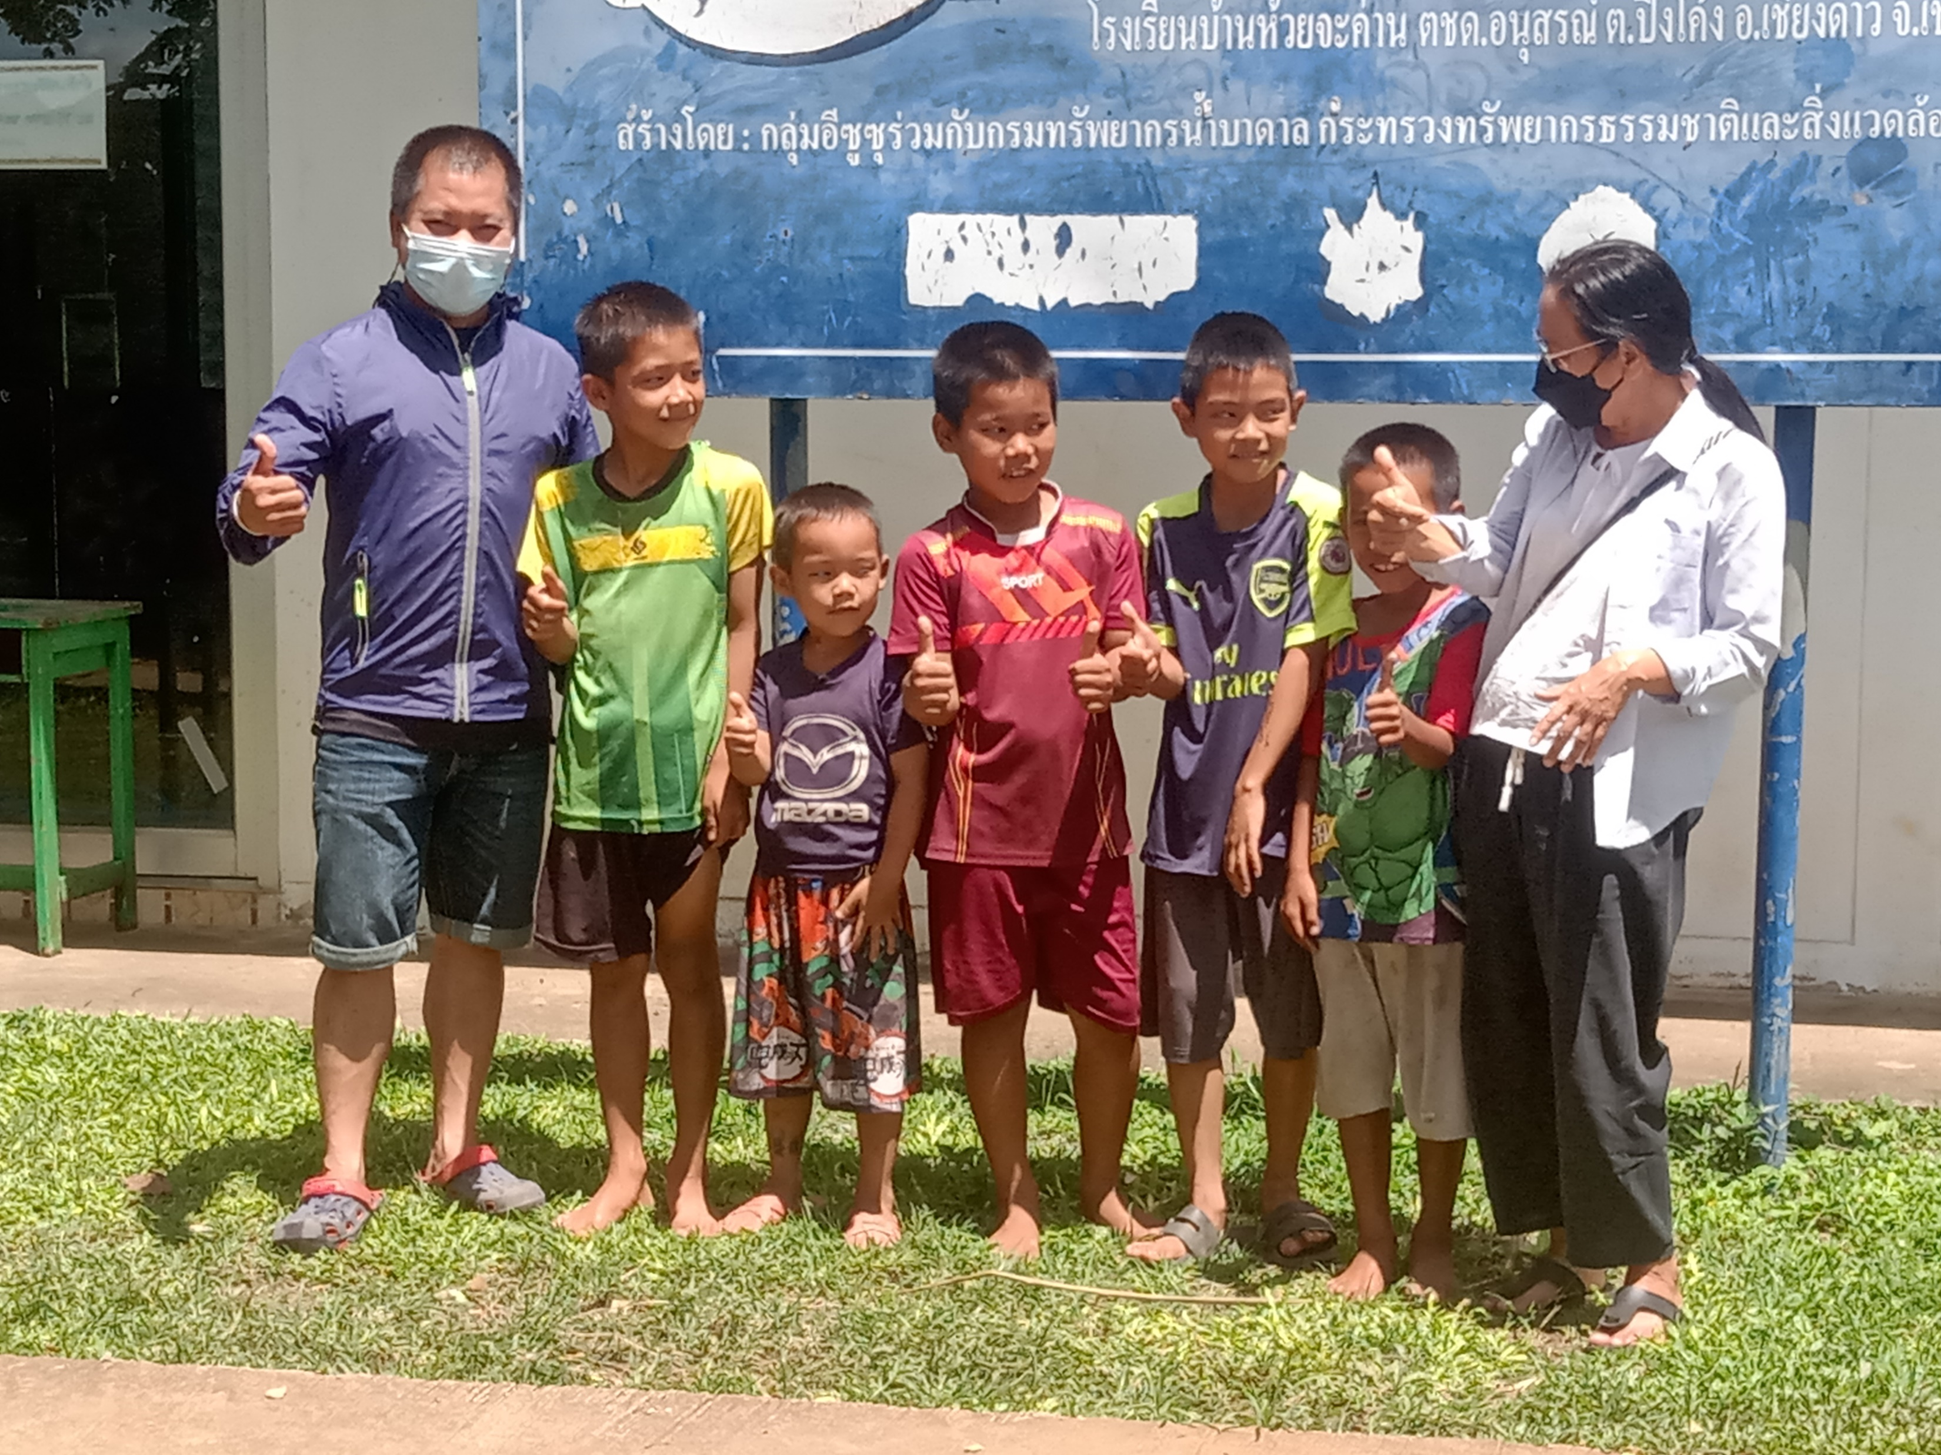
DEEP WELL
Bo Keo School
Agriculture Area
Kids drink this water!

Slide 11
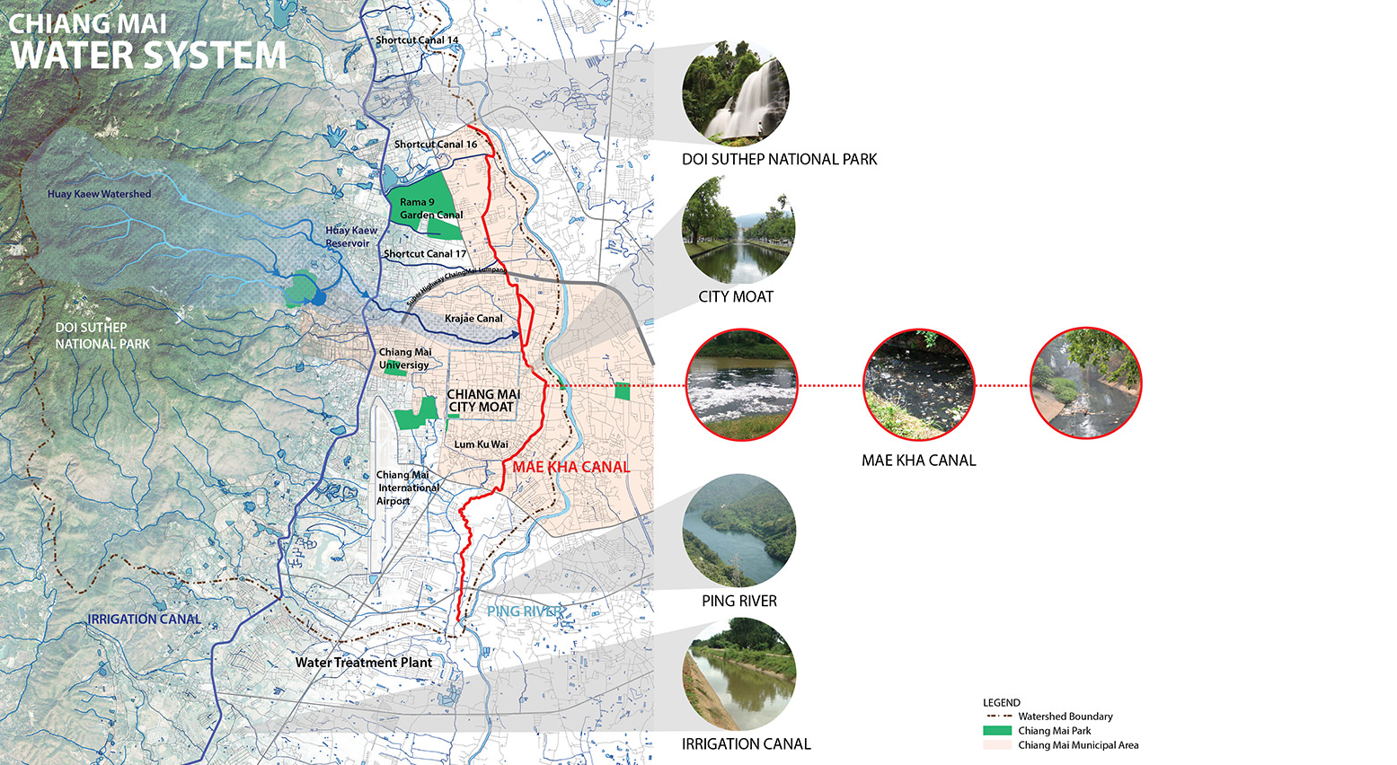
PN
Mae Kha Canal in Chiang Mai
Famous for being polluted
3 main drainages points to Ping River
Urban contaminants: sewage, hospital, industrial
LH
Sunantana Nuanla-or
(https://www.asla.org/2016studentawards/161372.html)
PS

Slide 12
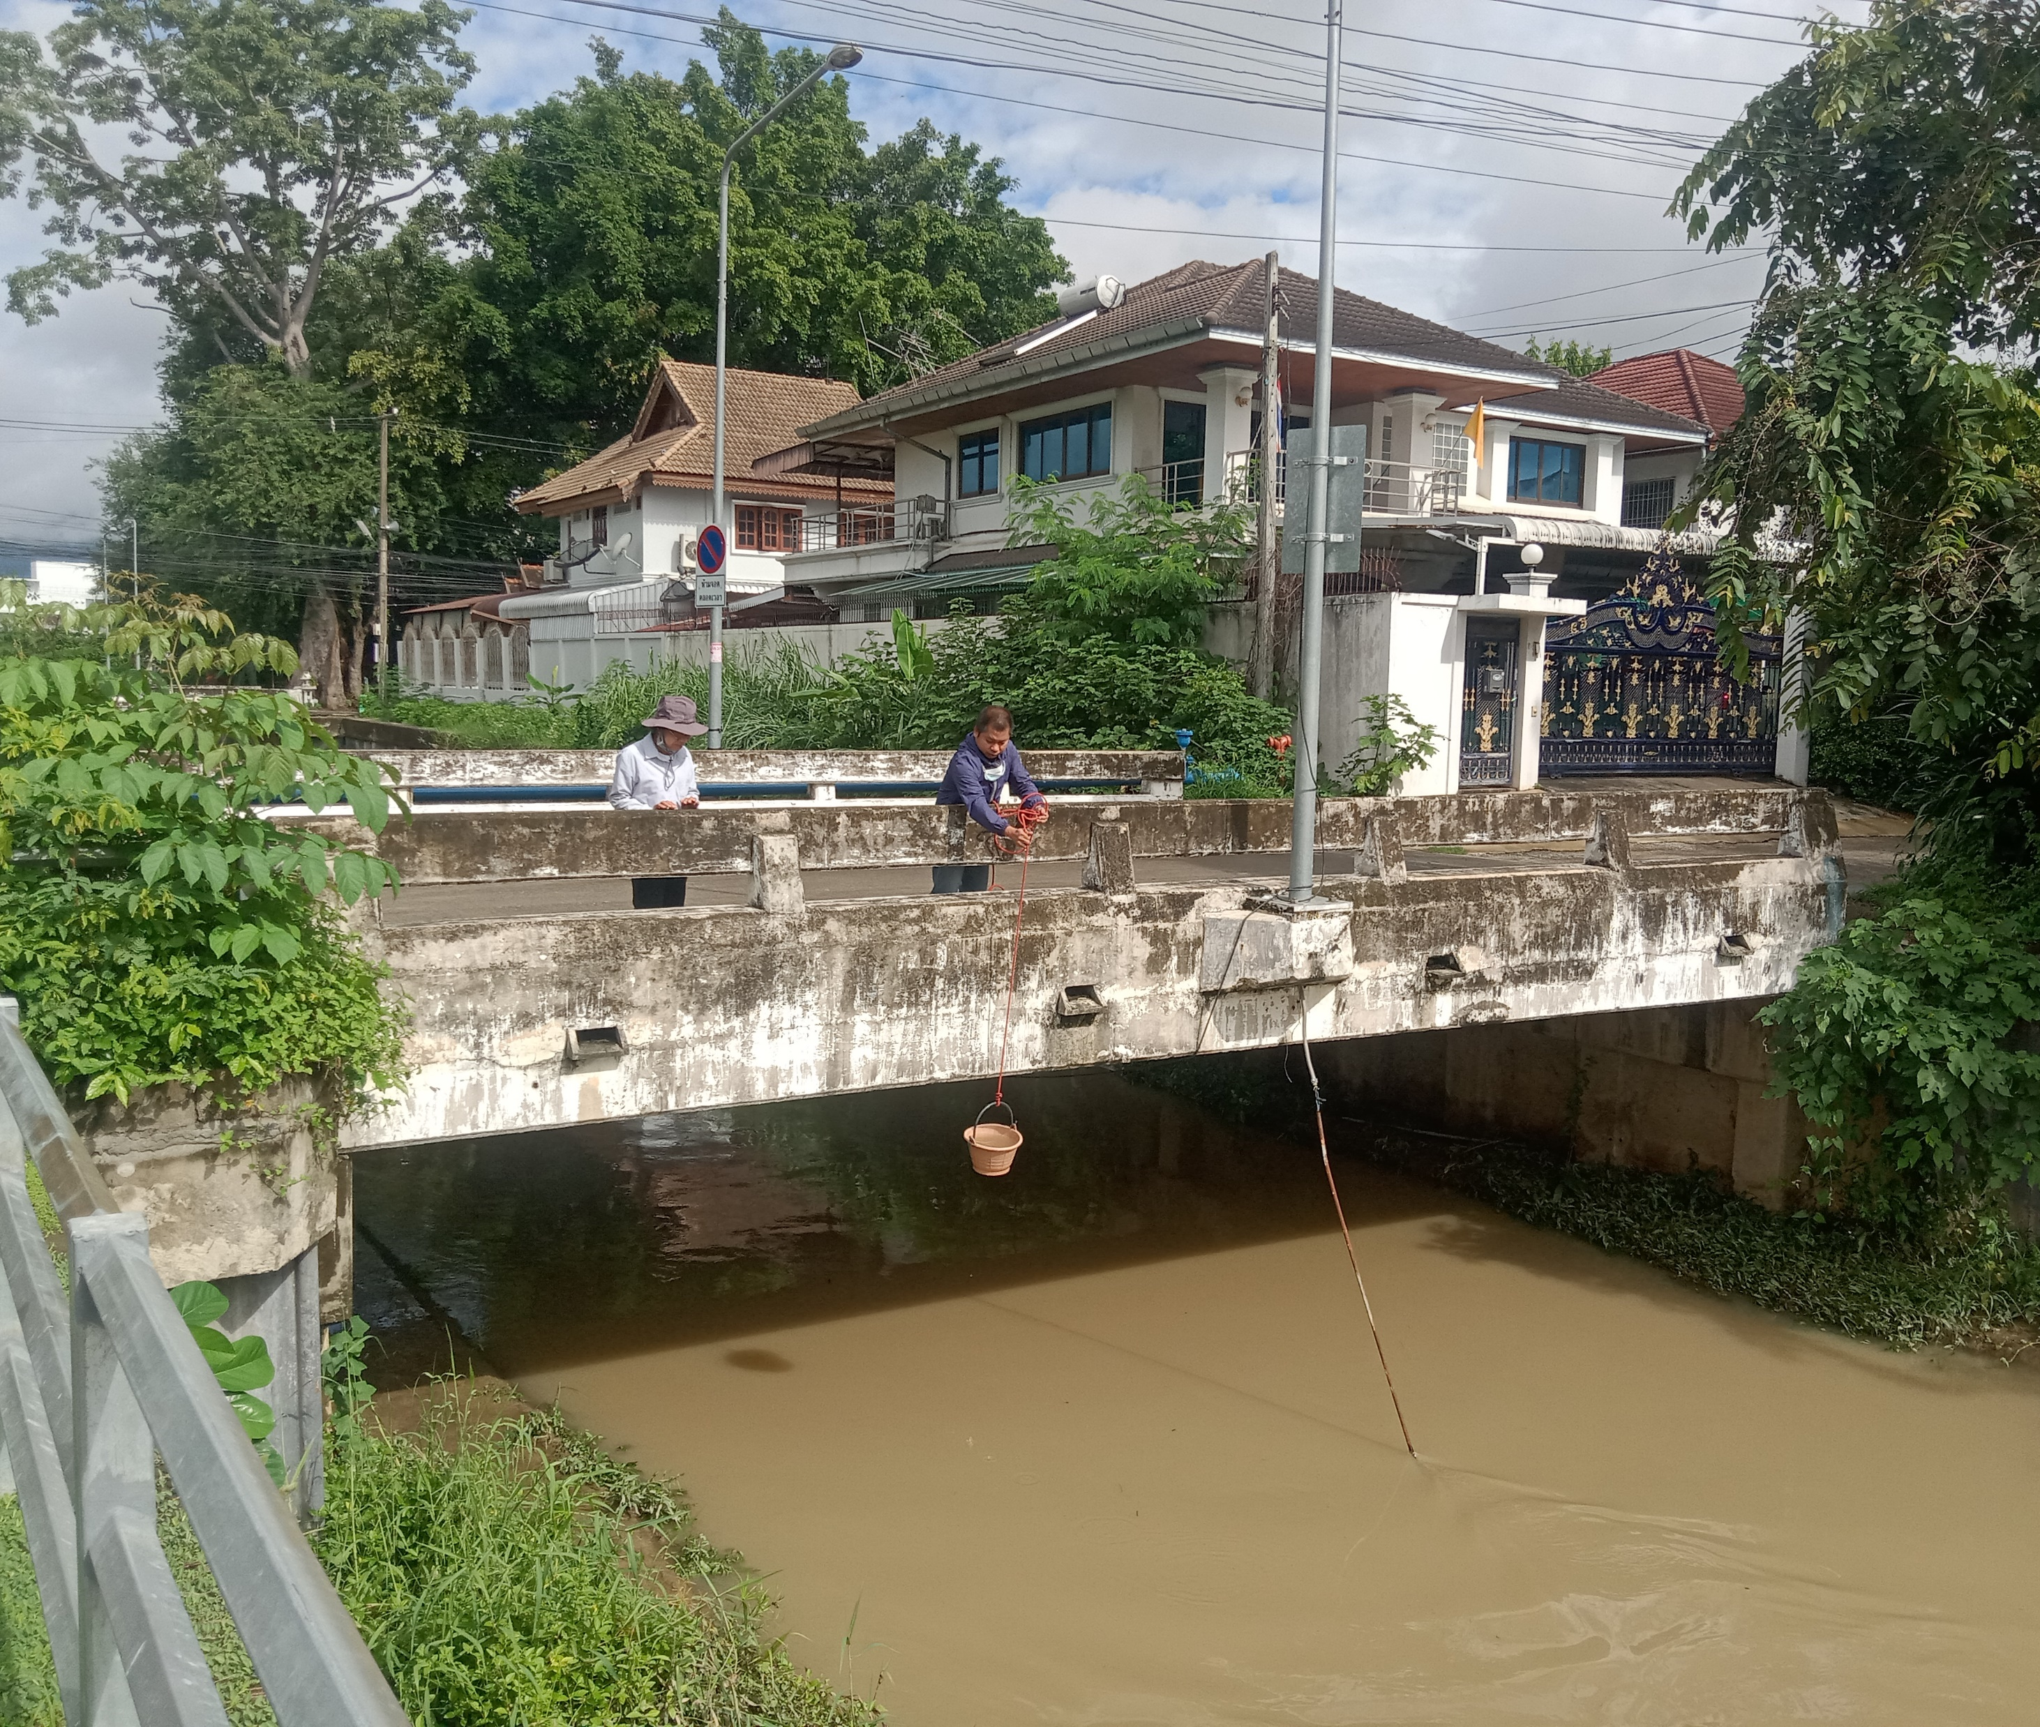
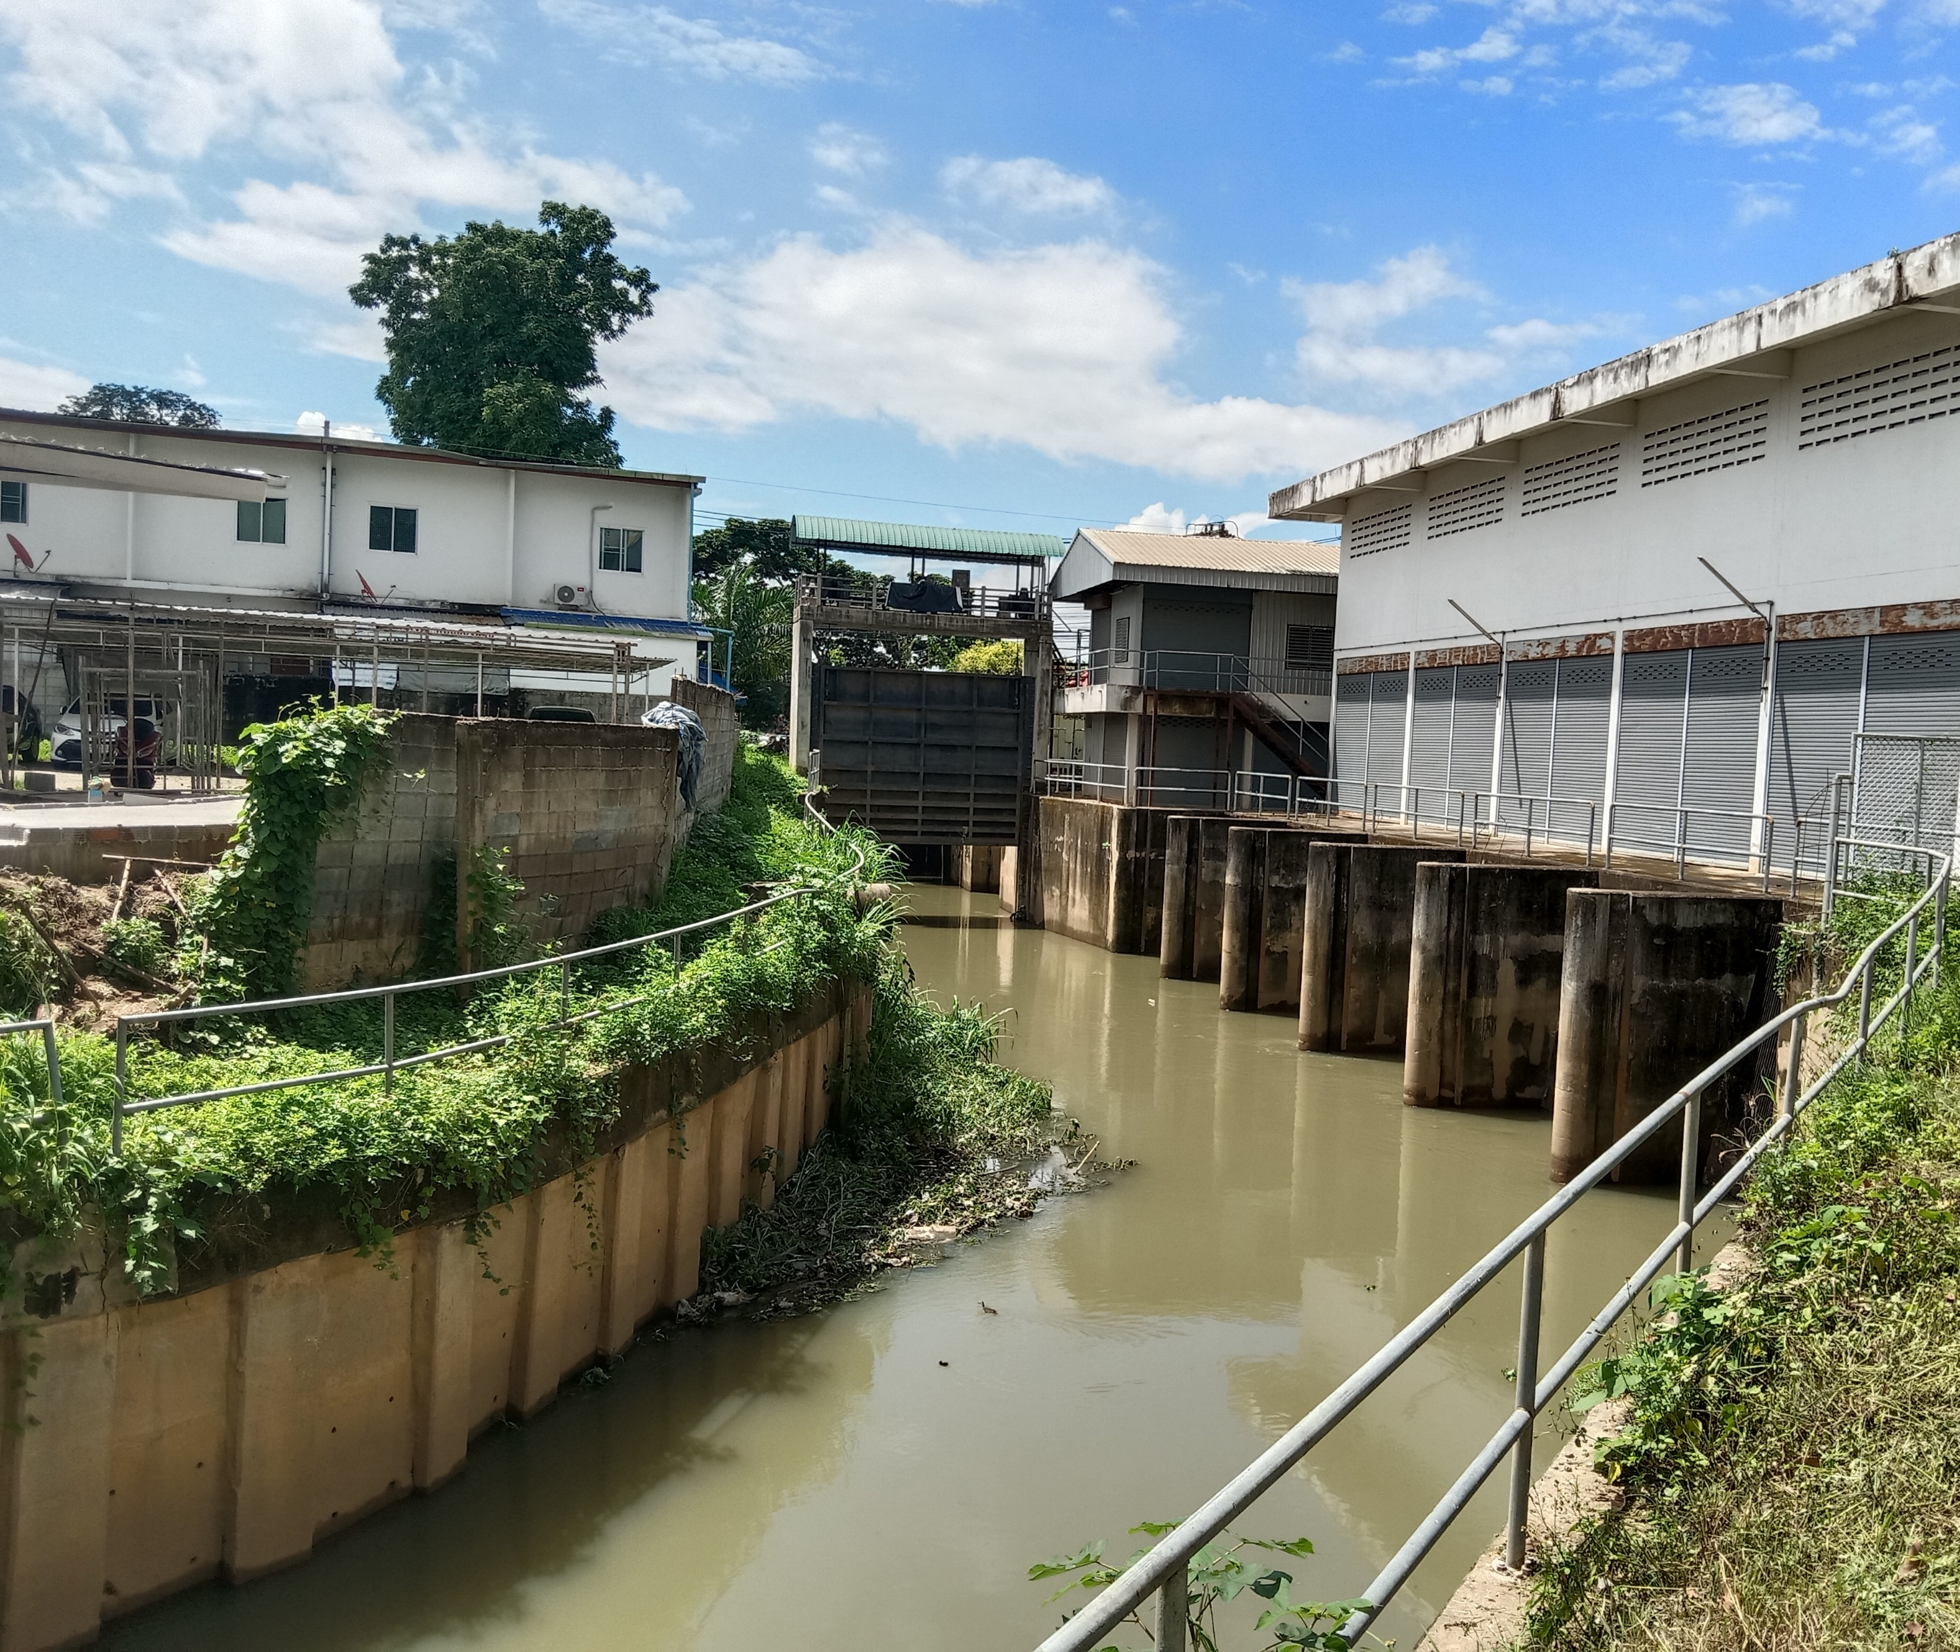
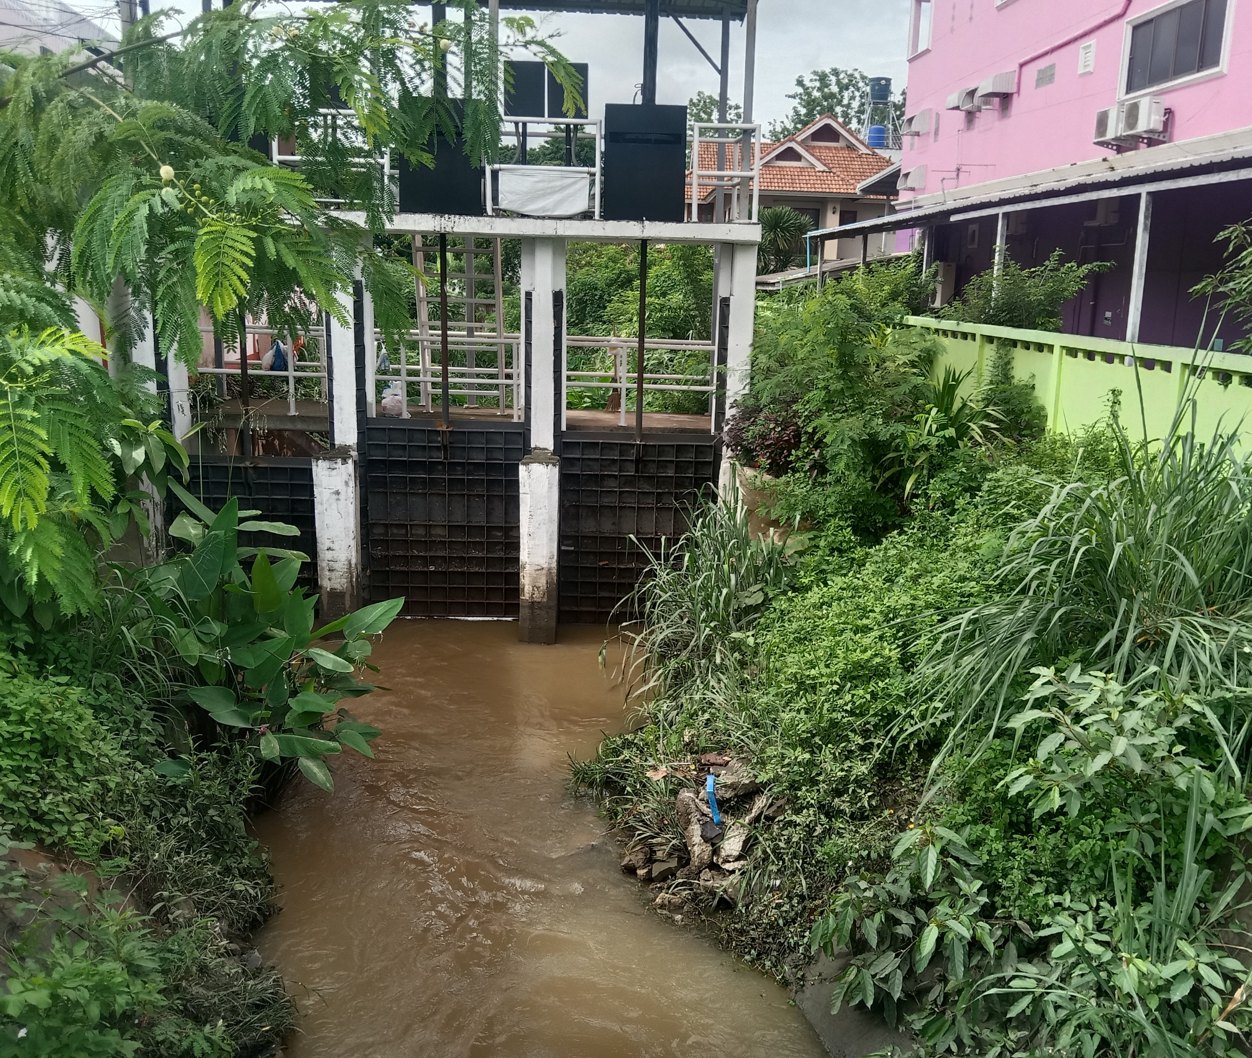
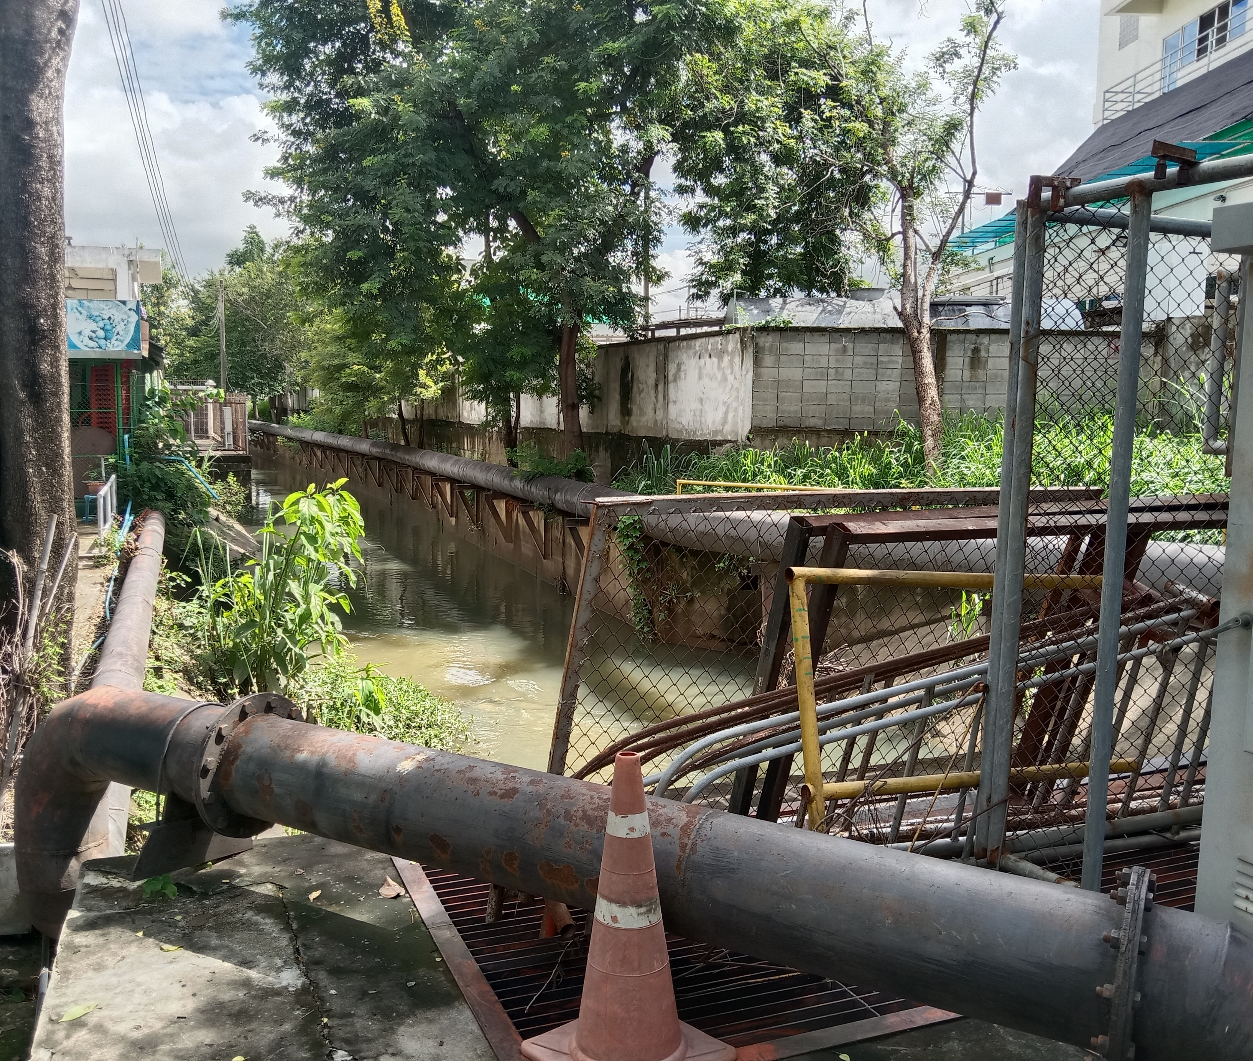
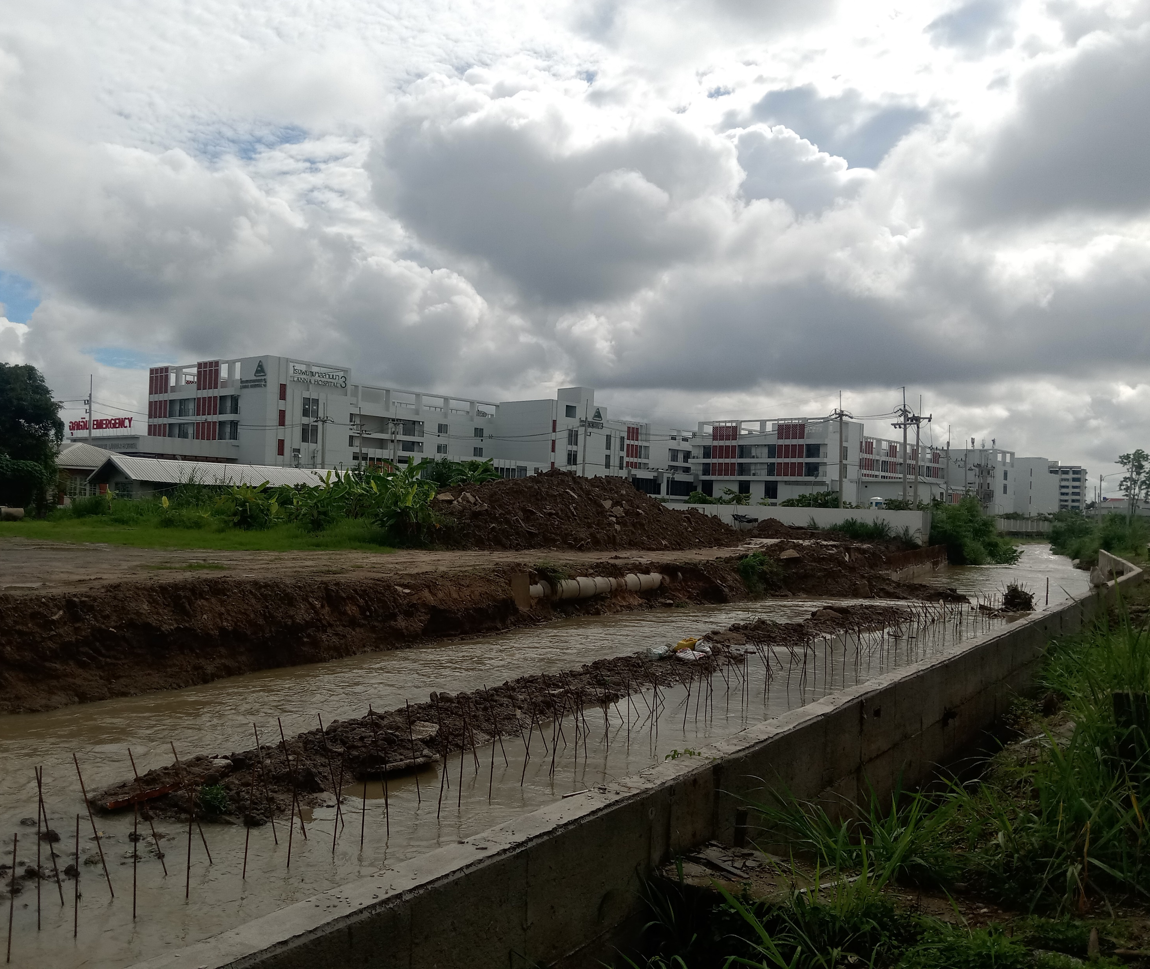
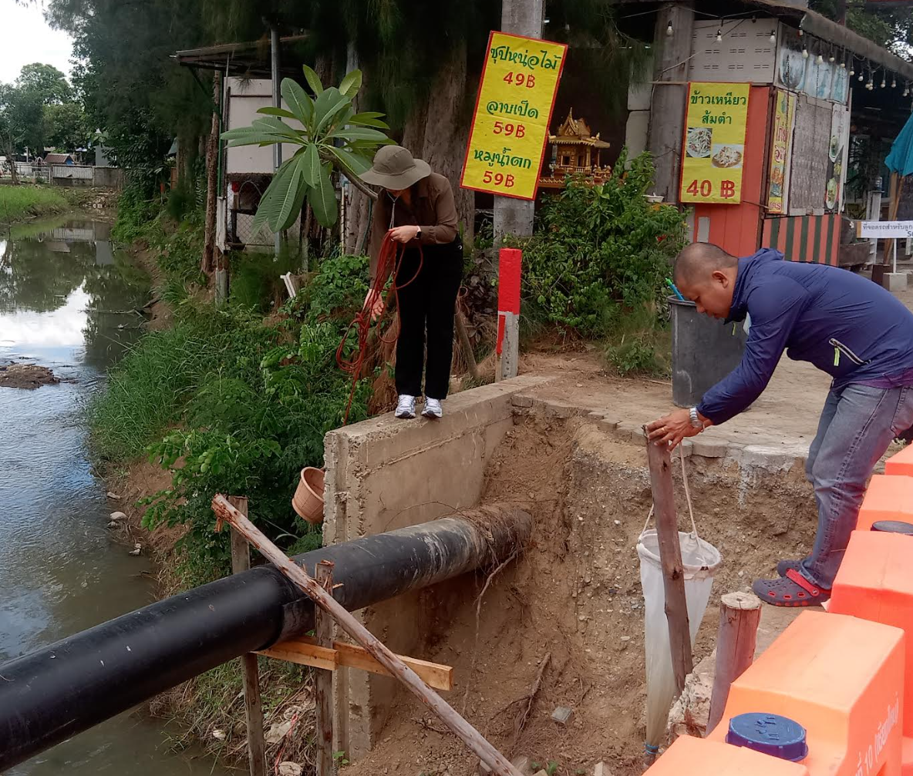
Sampling
Exit to the Ping
Eye clinic & Automotive
Mae Kha Canal
Ice Factory
Lanna Hospital Site
Road and domestic

Slide 13
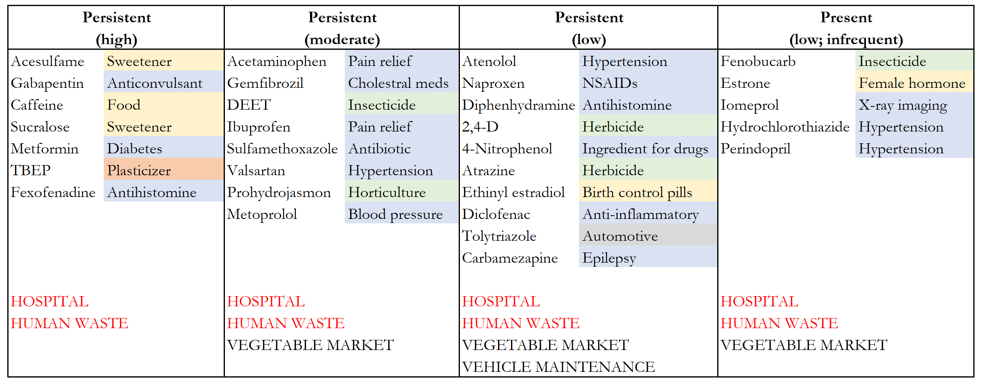
Canal draining from Lanna Hospital
Water drains to Ping River in less than 400 m

Slide 14
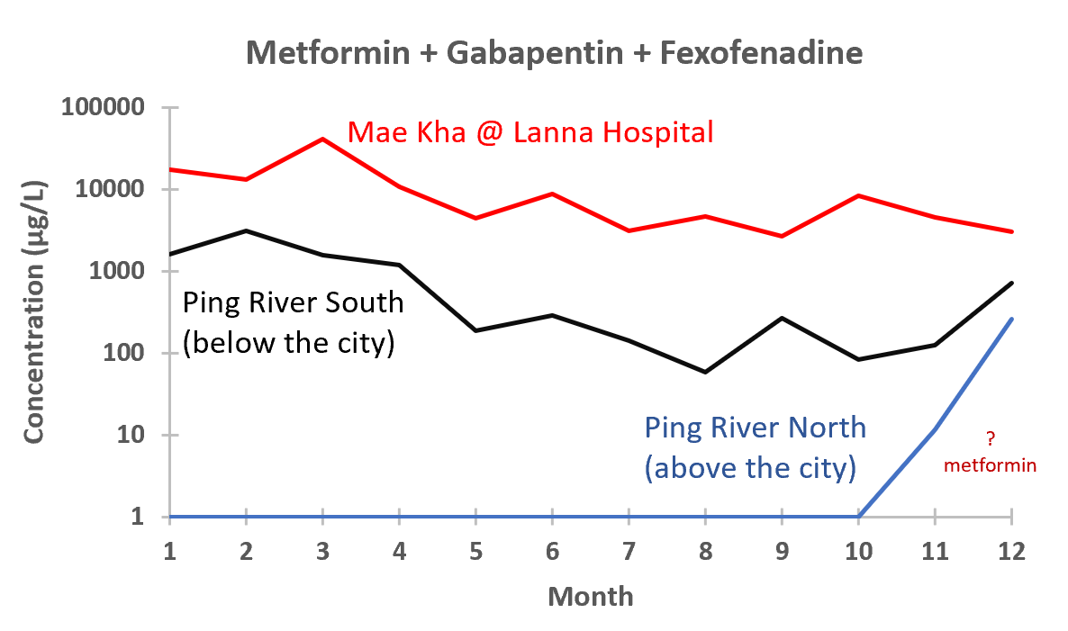
EXAMPLE: PHARMACEUTICALS
TAKE HOME
Hospitals, and likely domestic, sewage are important sources of pharmaceuticals entering the Ping River system.
The Ping signals follows that of the Mae Kha

Slide 15
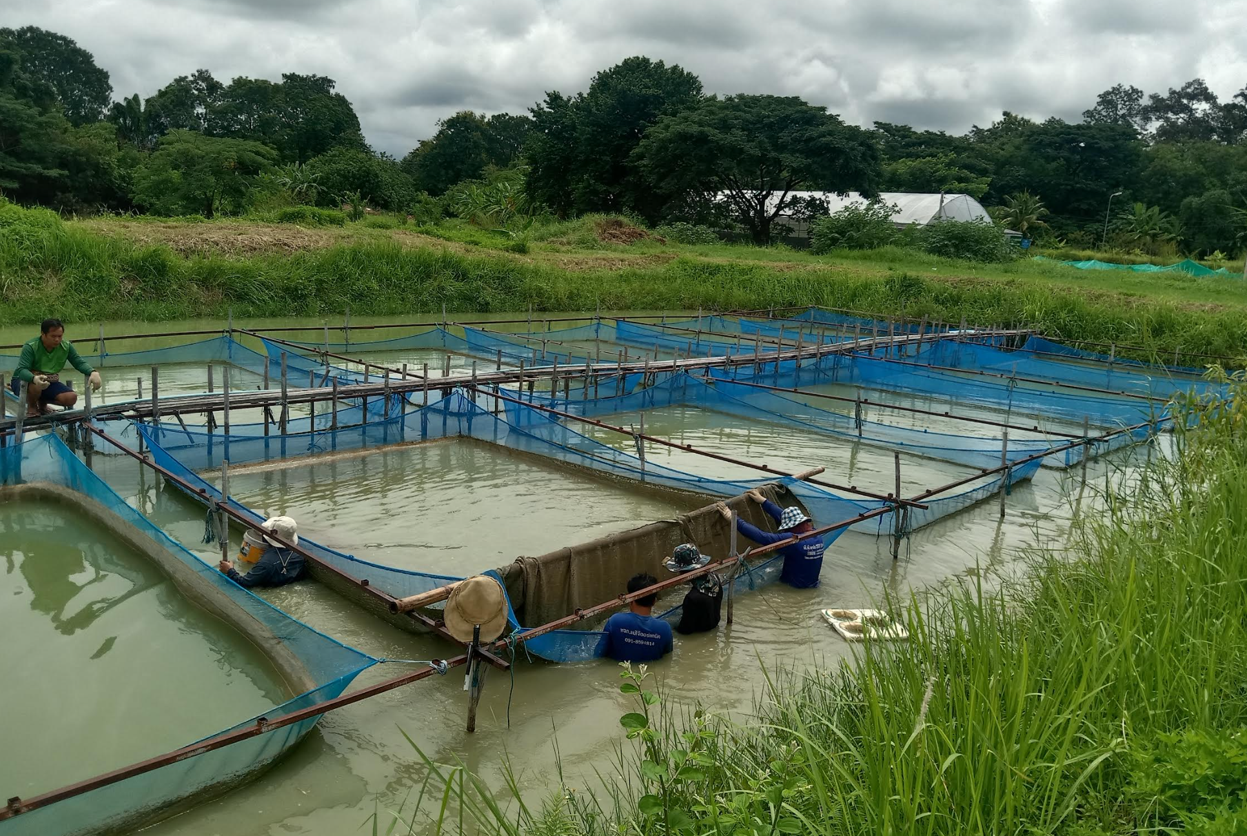
QUESTION: How are fish affected by contaminants,
Especially endocrine-disrupting compounds?
Tilapia

Slide 16
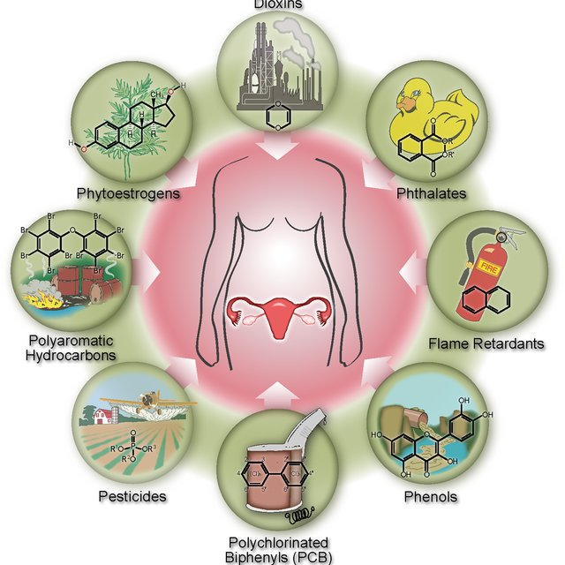
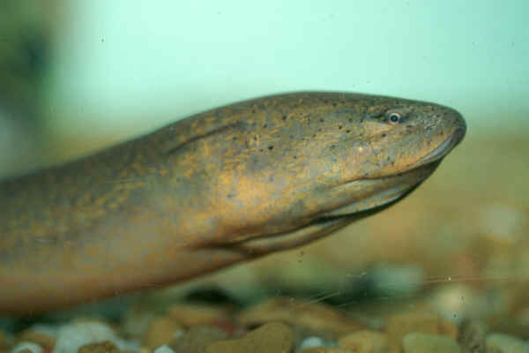
ENDOCRINE DISRUPTING COMPOUNDS (EDC)
Most work pertains to human risk
MJU: Fisheries and aquatic resources focus
Monopterus albus
Important aquaculture species in SE Asia
Born as female; transitions to male at 2-4 years.
EDC potentially alter this process
Concerns: pesticides, industrial compounds, hormones

Slide 17
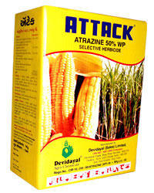
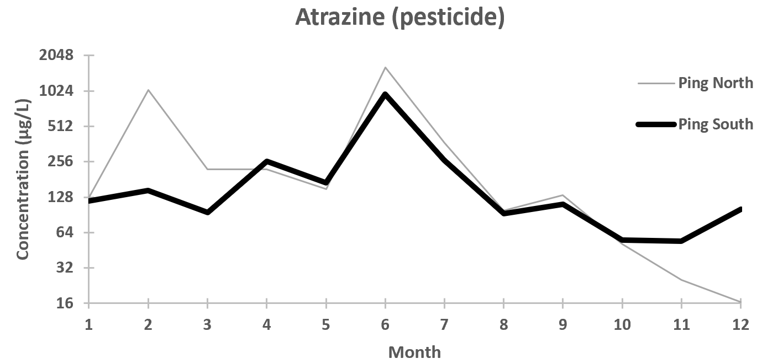
EXAMPLE: Atrazine (herbicide)
Start of rains
Anomalous rain
Ping North
(Ag; before city)
Ping South
(After city; some ag)
Wet Period
Early rain
Dilution
First Flush
Generally Low
(no rain)
Seasonal cultivation in northern part of Thailand leads to widely uses of agrochemicals especially atrazine herbicide (Thitiphuree et al., 2003)
Notes:
Atrazine is a herbicide. Likely applied in dry season prior to wet period to kill grass in preparation of planting. Over time it degrades. But it there when those first rains come so it gets “flushed” into the river system. Over time the concentration declines and the increasing rainfall causes a dilution effect. We see a spike when the first period of heavy rainfall comes about June.

Slide 18
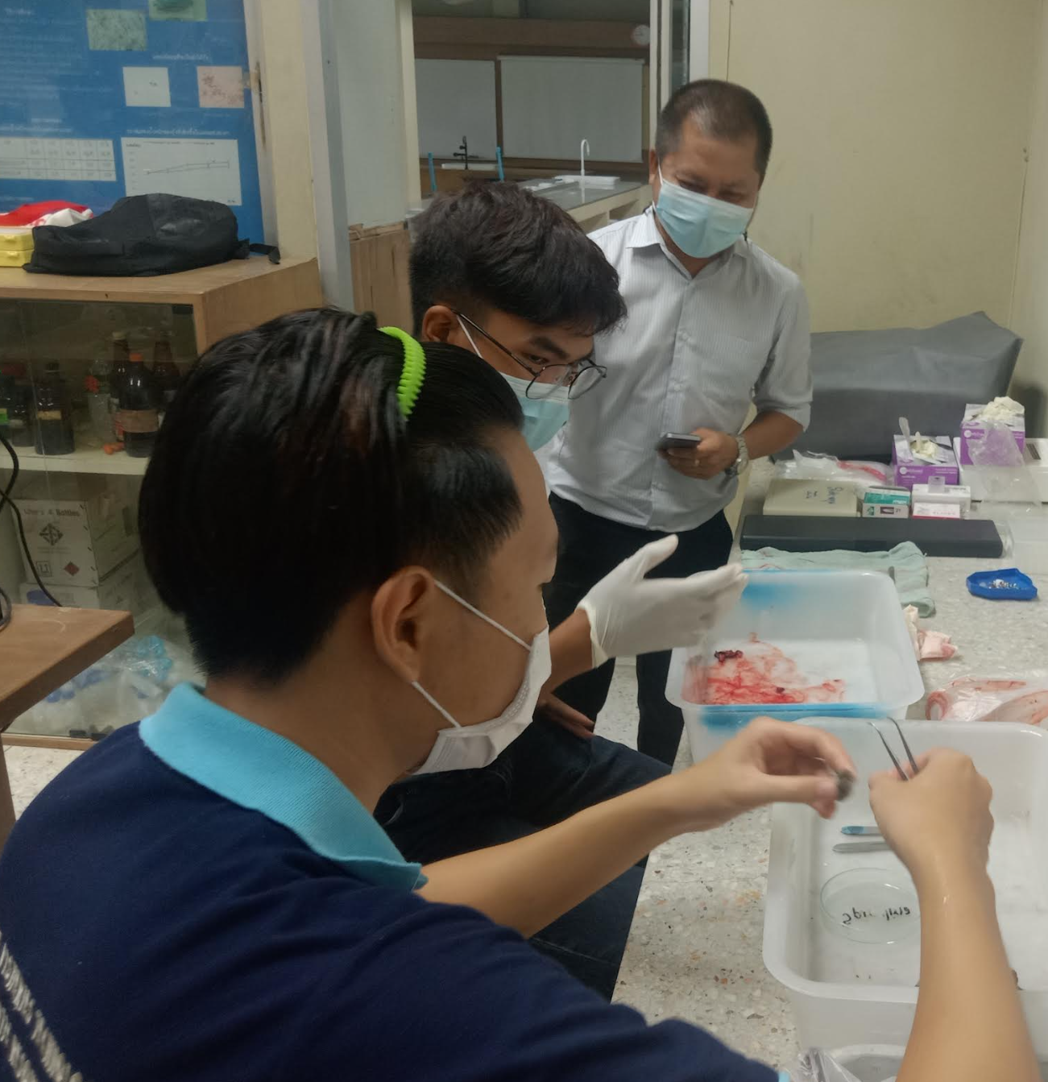
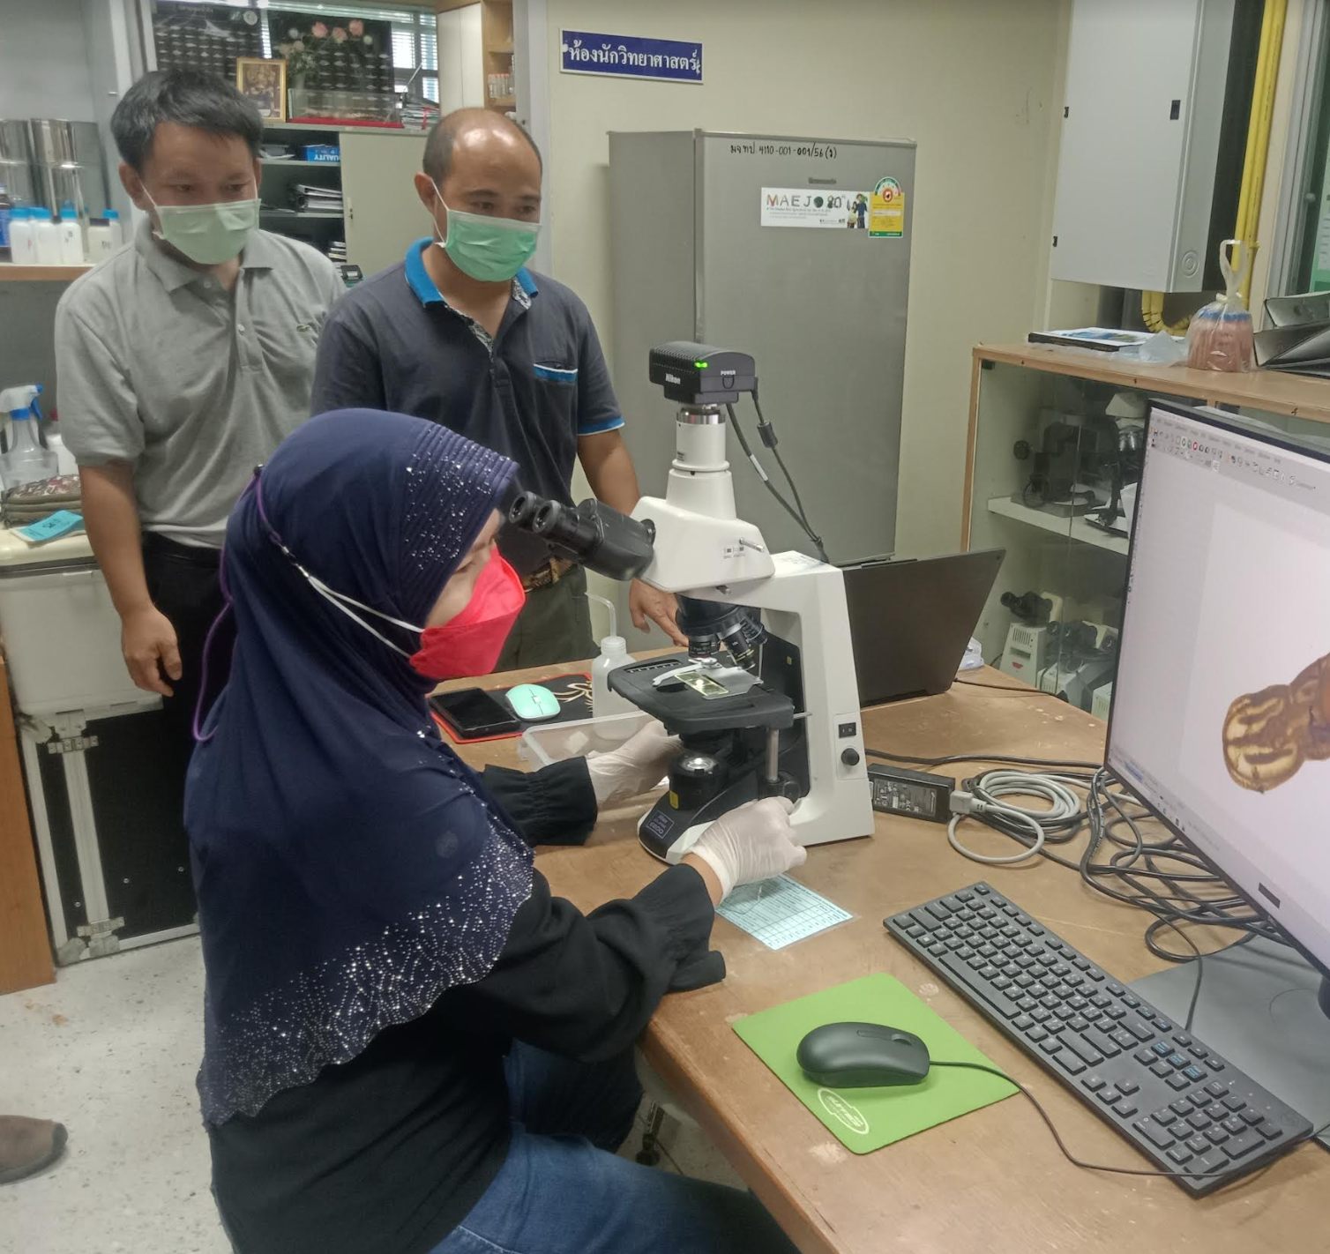
NEW GRADUATE WORK: understanding how ENCs
affect sexual maturation of swamp eels.

Slide 19
Chemicals present in 4 bottled water samples
Acetafeme | Bisphenal A | Caffeine | DEET | Hymecromone | Sucralose | Valsartan
x | x |  | x |  | x
x |  |  |  | x | x
 |  |  |  | x
x |  | x | x | x |  | x
X: Present, but in low concentrations (Targeted Analysis)
KEY
Acetafeme Artificial sweetener
Bisphenal A Plasticizer
Caffeine Food/drink
DEET Pesticides
Hymecromone Treats biliary spasms
Sucralose Artificial sweetener
Valsartan Hypertension & heart med

